Slide 1
Note AGU

Slide 2
Logiciels
Node > 12
Git 2.31.1
Visual Studio Code
Optionnel : Tortoise git
Angular CLI

Slide 3
Architecture
Front-End (Présentation)
Back-end (Métier)
Données

Slide 4
git init

Slide 5
Extensions VSCode
Javascript (ES6)
Prettier ( + format on save)
Git Graph
Javascript console utils
Angular Language Services
Auto Import

Slide 6
1995
Javascript
1998
ES2
1999
ES3
2009
ES5
2015
ES6
2016
ES7
ES2021
ESNext
var
1997
ECMAScript 1
const
let
2012
TS1

Slide 7
HTTP
Client
HTTP Request
Server
HTTP response
HTTP Request :
HTTP Response
HTTP/1.0 201 Created
Key: value
Content-Type: text/plain
Content-Length: 13
Asdfasdf: aasdfasdf
X-asdfasdfasdf: 123
Asdfasdf asdf asdf
Commande
POST /toto/titi HTTP/1.1
Key: valeur
Content-Type: text/plain
Content-Length: 23
Accept: *
Blabla: 456
Asdfasdf asdf asdf asdf asdfasdfasdf
Header
Body

Slide 8
Cycle de dev
k
ng build --prod
ng serve -o
ng lint
ng test
ng e2e
Jasmine
Karma
Jasmine
protractor

Slide 9
Javascript -> programmation ASYNCHRONE

Slide 10
5 Angular Artefacts
Module (paquet d’artefacts sauf modules)
Contient des artefacts (sauf modules)
Importe des modules
Exporte des artefacts (y compris modules)
Cas Utilisation :
Paquet de truc
Bootstrap module
Aspect module (ex: routing)
Composant
Directive
Pipe
Service
k

Slide 11
Composant
racine
Composant
A
B
Intelligent (classe)
Visuelle
(HTML et CSS) – template)
C

Slide 12
Directive
Artefact
Directive
Directive
Component
Intelligente
Directive Element : router-outlet, form
Directive Attribute : *ngIf, *ngFor, formControlName, etc.

Slide 13
Pipe (filter)
Cat toto.txt | grep truc | sort

Slide 14
Service = classe + DI
Composant
Classe du composant
Service
Service

Slide 15
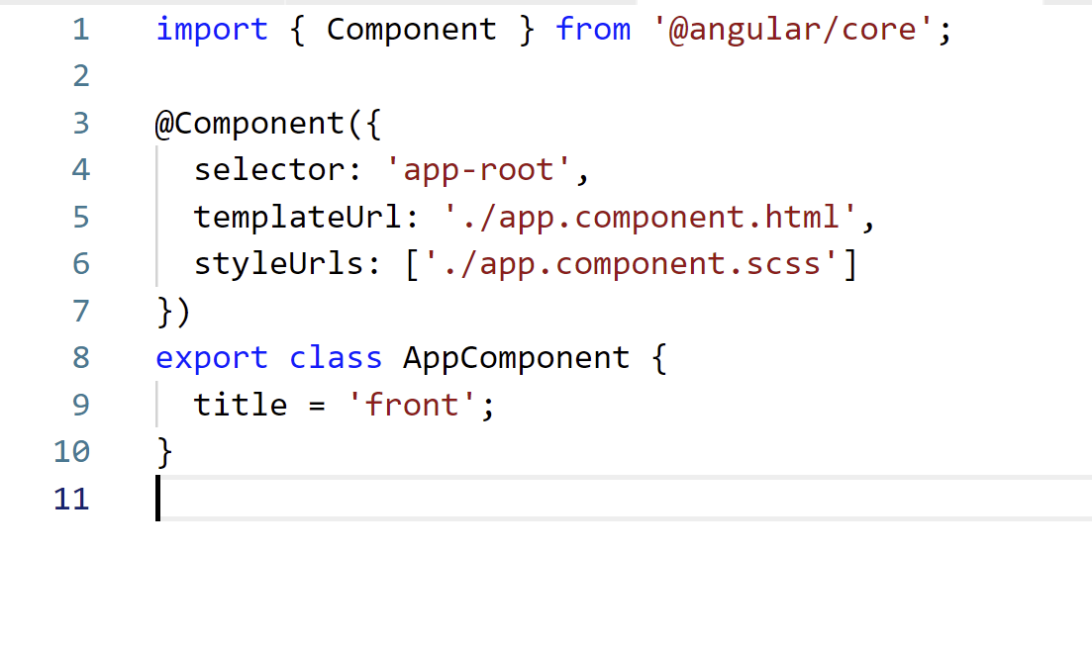
Terminologie
Nom du decorateur
Metadata
(objet en argument
du decorateur)

Slide 16
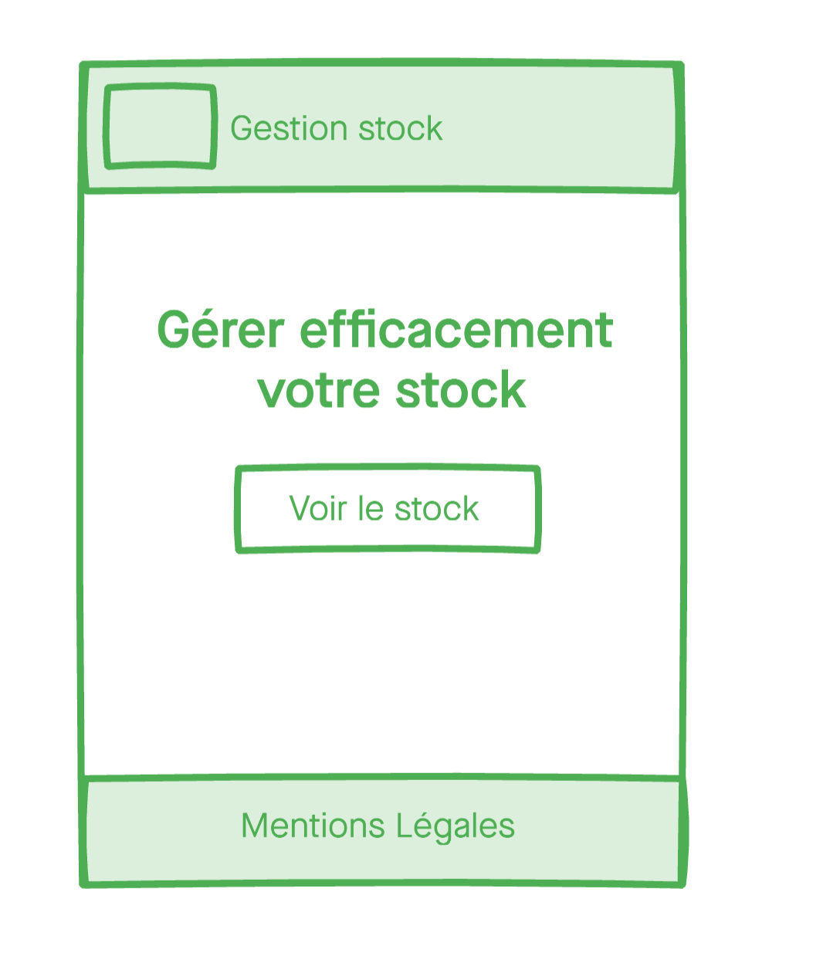
Maquette
App
Layout
App-root
Header
Body
Footer

Slide 17
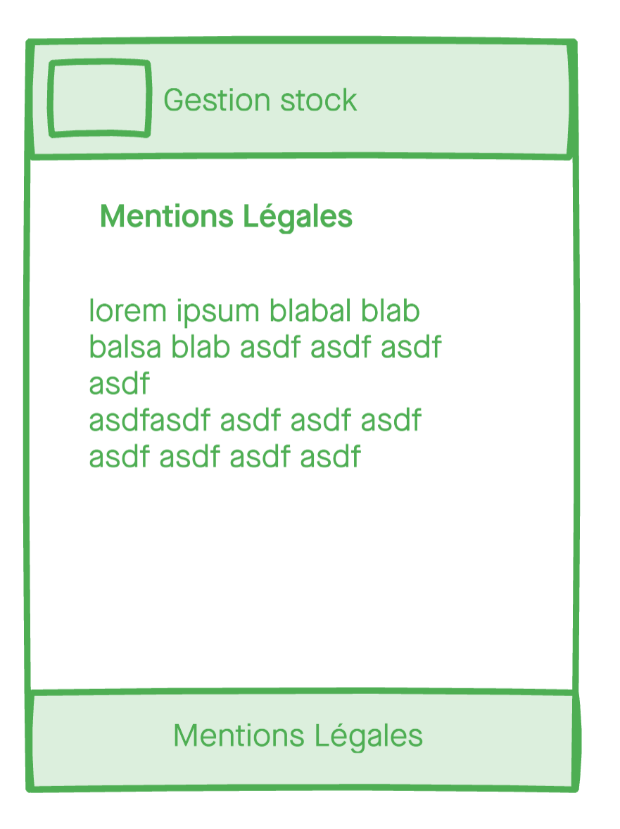
Routing
/
AppRouting
/legal
App
Step2
Layout
App-root
routes/
Step4 : liens
Router
Home
Header
Step1
Legal
Body
Step3
router-outlet
Footer
Step4 : liens

Slide 18
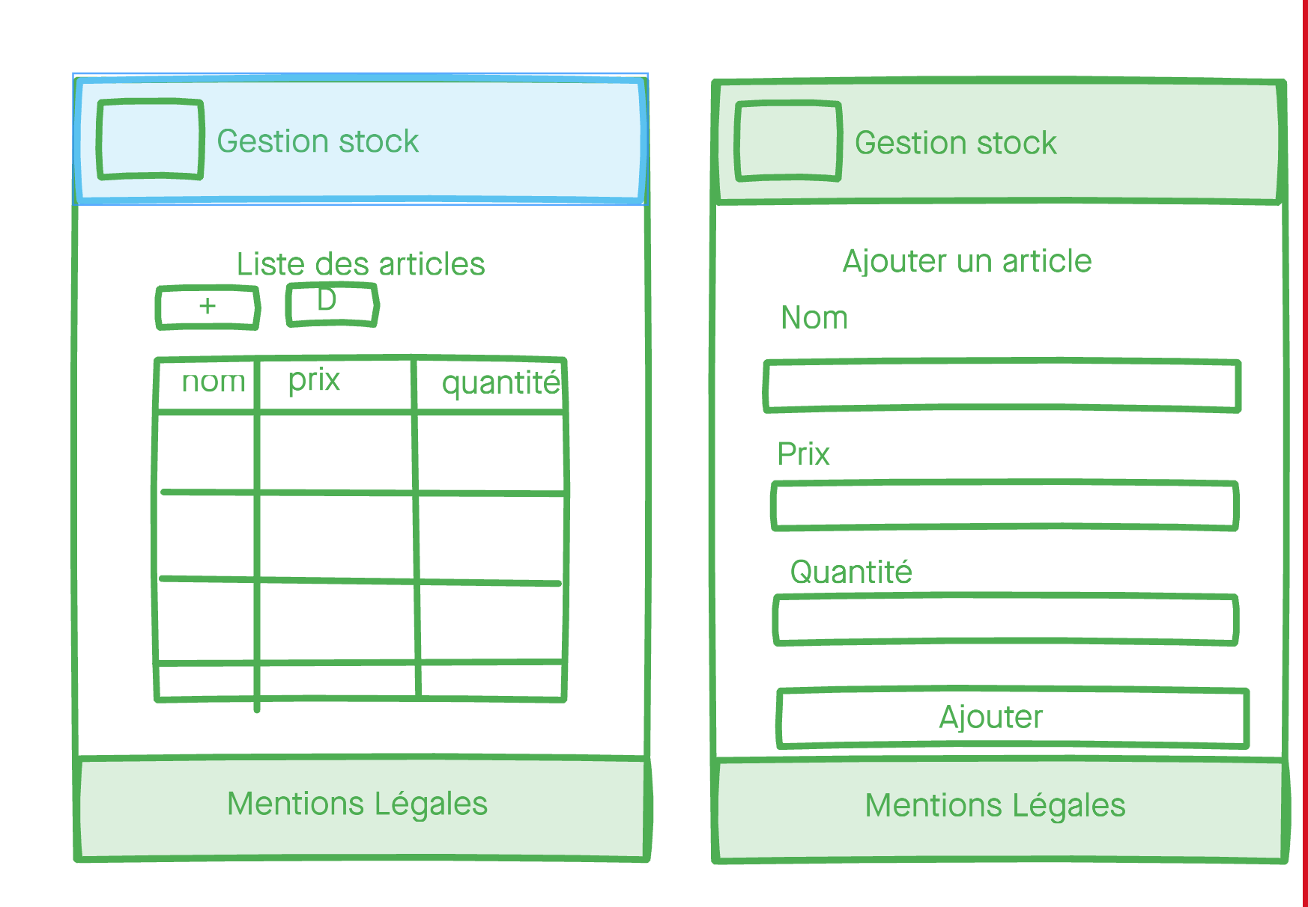
Reste des maquettes
Stock
StockRouting
/stock
/stock/add
Stock
Widget
Add

Slide 19
Ligne de vie
Refresh
Home
Stock
Add
Stock
Stock
Article
Article

Slide 20
Shared module
Widget
autofocus

Slide 21
Observable
next
next
next
next
complete
{…}
234
true
next
next
next
next
error
{…}
234
true
err

Slide 22
HttpClient
complete
next
{}
error
err

Slide 23
CORS
http://localhost:4202
ng serve
Browser
CORS
http://localhost:3000
back

Slide 24
Mode proxy
http://localhost:4202
ng serve
Browser
http://localhost:3000
back

Slide 25
Nginx
Nodejs (back)
Reverse proxy
nginx
Localhost:7777
HTTPS

